Slide 1
Programming Fundamentals
Dr. Abdul Aziz
Assistant Professor & HoD
Department of Software Engineering
NUCES-FAST, Karachi.

Slide 2
Week 3, Class 1

Slide 3
Escape Sequence
The purpose of the escape sequence is to represent the characters that cannot be used normally using the keyboard

Slide 4
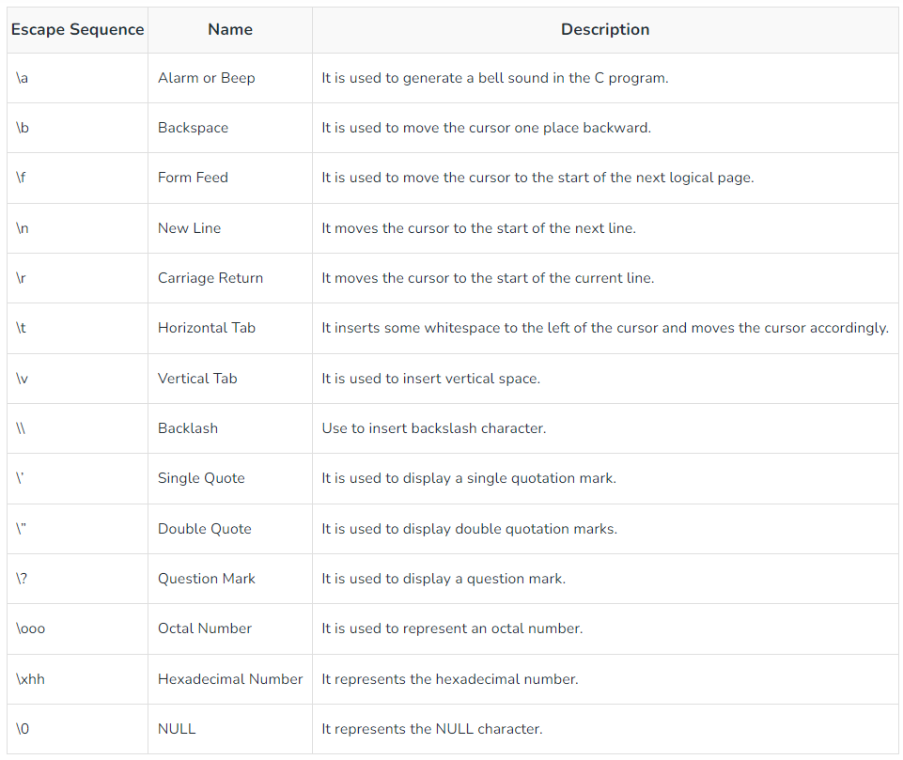

Slide 5
Program 1
Write a program to take an integer value as an input from user and print its table from 1 to 5.
Required : IPO and code.
Output:
3 x 1 = 3
3 x 2 = 6
3 x 3 = 9

Slide 6
IPO program 1
Data | Process | Output
int table; to store the user input | 1: print prompt to input the table user want to print. 2: Take input and save in table variable. 3: print output 5 times by multiplying table with 1 to 5. 4: end. | 3 x 1 = 3 3 x 2 = 6 3 x 3 = 9 3 x 3 = 12 3 x 3 = 15

Slide 7
Program 2
Write a program that takes 3 subject marks as input and print its total, marks obtain and percentage.
Required : IPO and code
Output:
Subject 1 = 70 /100
Subject 2 = 60 / 100
Subject 3 = 50 /100
Total Marks obtain = 180 / 300
Total percentage = 60 %

Slide 8
IPO program 2
Data | Process | Output
3 float variables to store subject marks. s1, s2 and s3. 1 float for total. 1 float for percentage. | 1: prompt user to input 3 subject marks. 2: Take input and save in s1, s2 and s3 variable. 3: calculate total marks and save in total variable by adding s1, s2 and s3. 4: calculate percentage and save in variable. Total*100/300. 5: print total 6: print percentage 7: end. | Subject 1 = 70 /100 Subject 2 = 60 / 100 Subject 3 = 50 /100 Total Marks obtain = 180/300 Total percentage = 60 %

Slide 9
Week 3, Class 2

Slide 10
Operators in C
Arithmetic Operator
Arithmetic Assignment
Increment / Decrement
Relational
Logical
Conditional
Bitwise
Special

Slide 11
Arithmetic Operator
+
-
*
/
%

Slide 12
Assignment Operators
=
*=
/=
+=
-=
%=

Slide 13
Increment / Decrement Operator
++
--

Slide 14
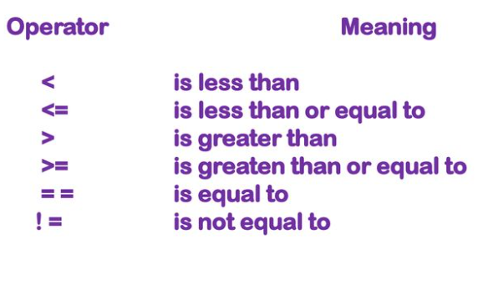
Relational Operator

Slide 15
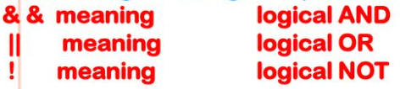
Logical Operator

Slide 16
Week 3, Class 3

Slide 17
Condition Operator
? (Ternary Operator)

Slide 18
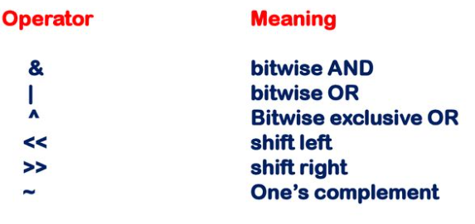
Bitwise Operator

Slide 19
Example
#include <stdio.h>
main() {
int p = 60; /* 60 = 0011 1100 */
int q = 13; /* 13 = 0000 1101 */
int r = 0;
r = p | q; /* 61 = 0011 1101 */
printf(“Line 1 – The value of r is %d\n”, r );
r = p & q; /* 12 = 0000 1100 */
printf(“Line 2 – The value of r is %d\n”, r );
r = ~p; /*-61 = 1100 0011 */
printf(“Line 3 – The value of r is %d\n”, r );
r = p ^ q; /* 49 = 0011 0001 */
printf(“Line 4 – The value of r is %d\n”, r );
r = p >> 2; /* 15 = 0000 1111 */
printf(“Line 5 – The value of r is %d\n”, r );
r = p << 2; /* 240 = 1111 0000 */
printf(“Line 6 – The value of r is %d\n”, r );
}

Slide 20
Special Operator
, Comma Operator
& Address Operator
Sizeof Operator
* and & Pointer Operator
. and -> Member Selection Operator
#

Slide 21
math.h
The math.h header defines various C mathematical functions
Example:
double ceil (double x)
double floor(double x)
double fabs(double x)
double log(double x)
double log10(double x)
double sqrt(double x)

Slide 22
Example
#include <math.h>
#include <stdio.h>
void main( void ){
float val1 = 1.6, val2= 1.2;
printf("value1 = %.1lf\n", ceil(val1));
printf("value2 = %.1lf\n", ceil(val2));
}

Slide 23
Example
void main()
{
double x, ret;
x = 2.7;
/* finding log(2.7) */
ret = log(x);
printf("log(%lf) = %lf", x, ret);
return (0);
}
OUTPUT:
log(2.700000) = 0.993252

